Slide 1

AJAX-4
SHARMA COMPUTER ACADEMY

Slide 2
What is a promise ?
In JavaScript, a Promise is an object that returns a value which we hope to receive in future, but not now.
Because the value will be returned by the Promise object in the future, it is very well-suited for handling asynchronous operations.

Slide 3
A real world example
It’ll be easier to understand the concept of JavaScript promises through a real world example.
Suppose that you promise to complete your JavaScript project by next month.

Slide 4
A real world example
Now you don’t know if you will be really able to complete the project until next month.
You can either be completing it or not.
Thus there are three possibilities:
Pending: you don’t know if you will complete the project by next month.
Fulfilled: you completed your project by the next month.
Rejected: you couldn’t complete the project.

Slide 5
States of a promise
A Promise in JavaScript just like a promise in real-world has 3 states.
It can be:
1. unresolved (pending),
2. resolved (fulfilled), or
3. rejected

Slide 6
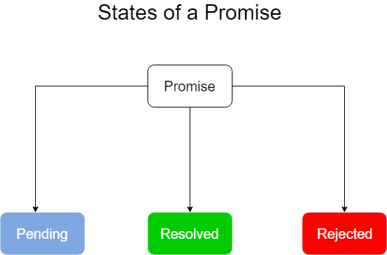
States of a promise

Slide 7
Steps needed for promise
In order to work with Promise , we need to take 2 steps:
1. Creating A Promise
2. Consuming A Promise

Slide 8
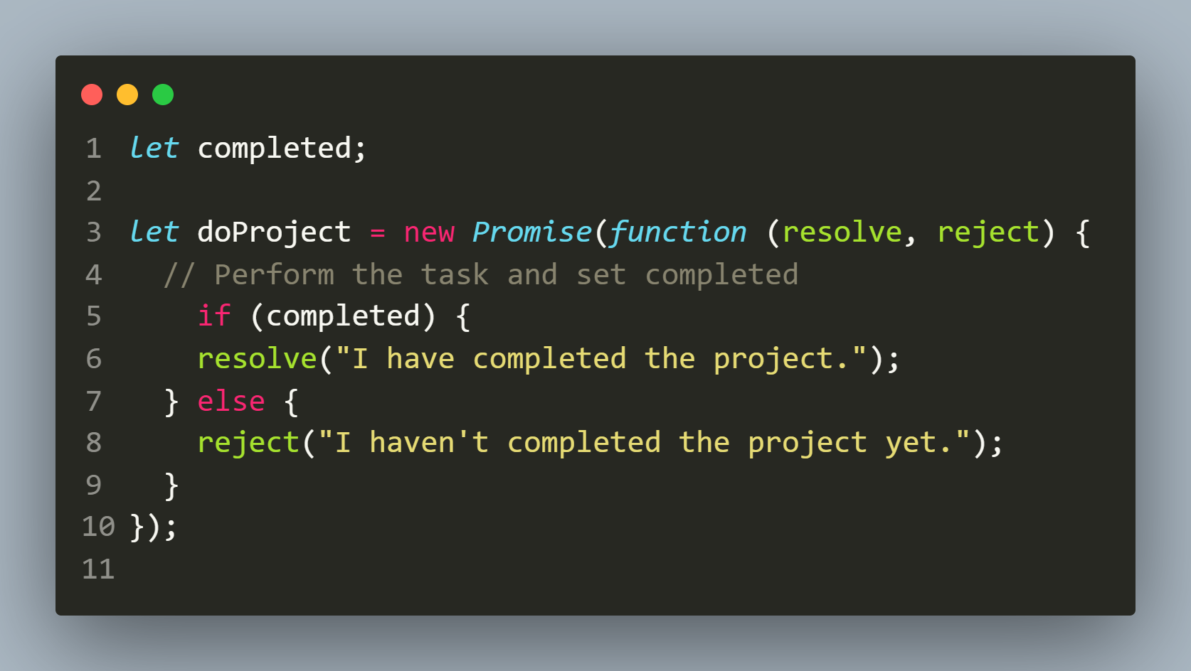
Step 1: Creating a promise
To create a promise in JavaScript, we use the Promise constructor:

Slide 9
explanation
The Promise constructor accepts a function as an argument.
This function is called the executor.
The executor accepts two functions with the names, by convention, resolve() and reject().

Slide 10
explanation
When we call the new Promise(executor), the executor is called automatically.
Inside the executor, we do 4 things:
Perform the task.
Check whether it completed successfully or not.
If the task is completed successfully, we call resolve() .
If the task fails then we call reject().

Slide 11
explanation
Calling the resolve() function moves the promise object to the fulfilled state.
Calling the reject() method moves the promise object to the rejected state.

Slide 12
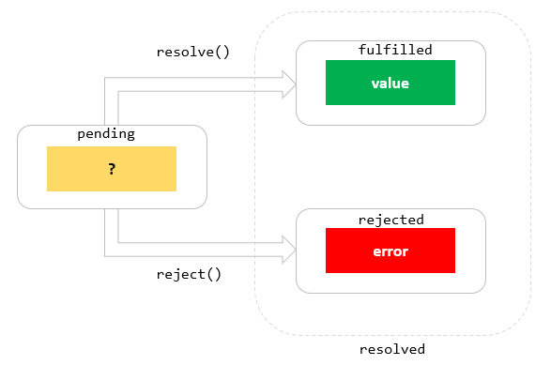
Resolve() and reject() effect

Slide 13
Points to remember
Once the promise reaches either fulfilled state or rejected state, it stays in that state and can’t switch.
In other words, a promise cannot go from the fulfilled state to the rejected state and vice versa.

Slide 14
Points to remember
It also cannot go back from the fulfilled state or rejected state to the pending state.
If the promise reaches fulfilled state or rejected state, the promise is resolved.

Slide 15
Step 2: Consuming a promise
Now that we know how to create a promise, let’s understand how to consume an already created promise.
We consume a promise by calling it’s two methods :
then() and catch().

Slide 16
Then() method
The then() method is used to schedule a callback to be executed when the promise is successfully resolved.
It takes two callback functions:
Syntax:
promiseObject.then(onFulfilled, onRejected);
The onFulfilled callback is called if the promise is fulfilled.
The onRejected callback is called when the promise is rejected.

Slide 17
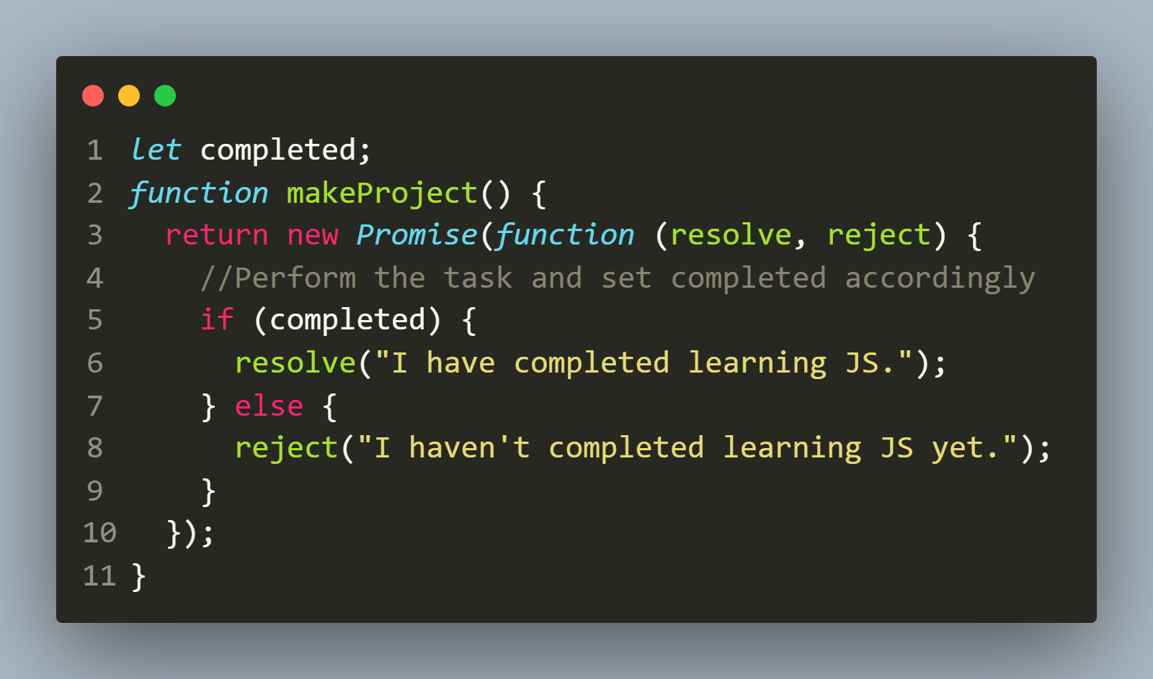
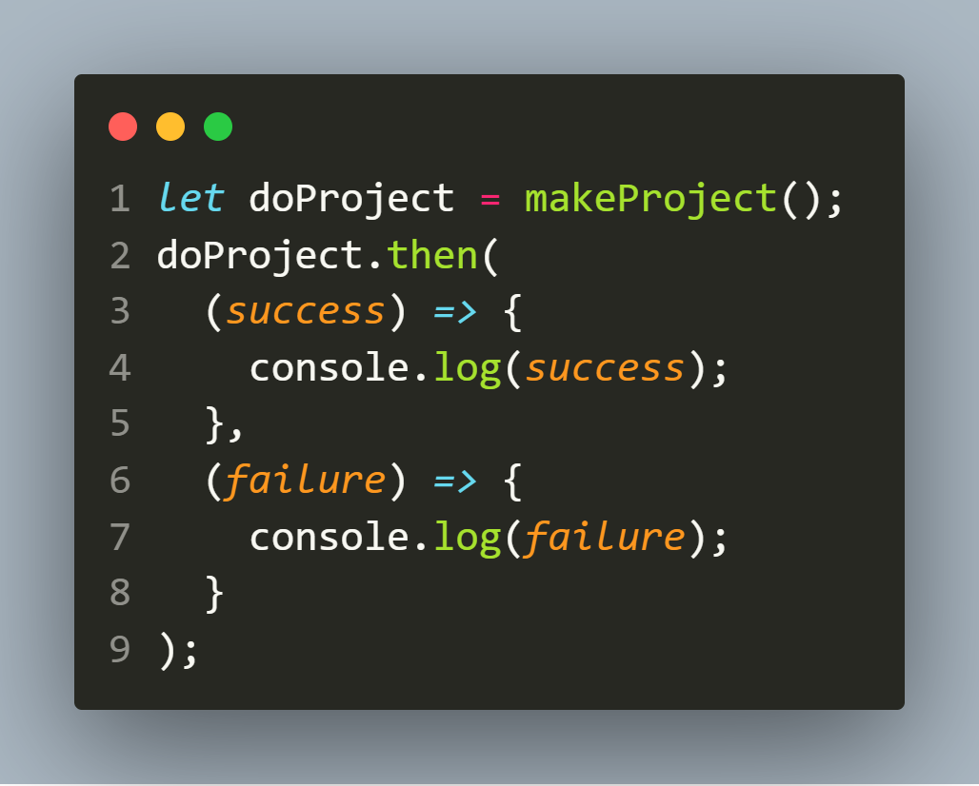
Then() method
Creating A Promise
Consuming A Promise

Slide 18
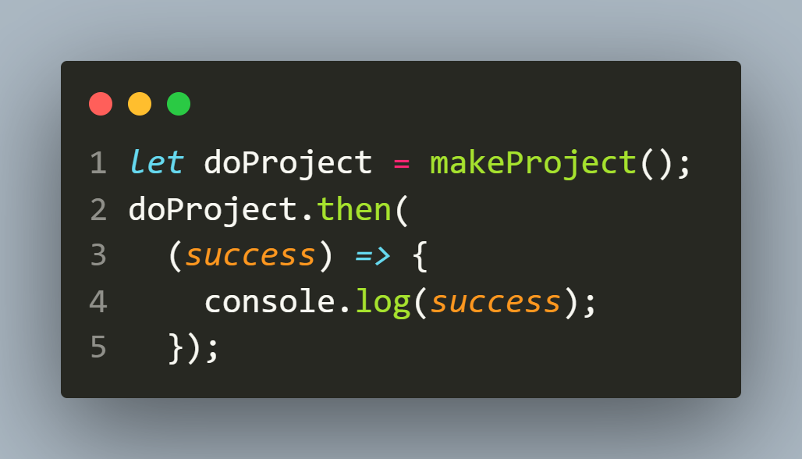
Handling only one state
It is possible to schedule a callback to handle the fulfilled or rejected case only.
The following runs the fulfilled case:

Slide 19
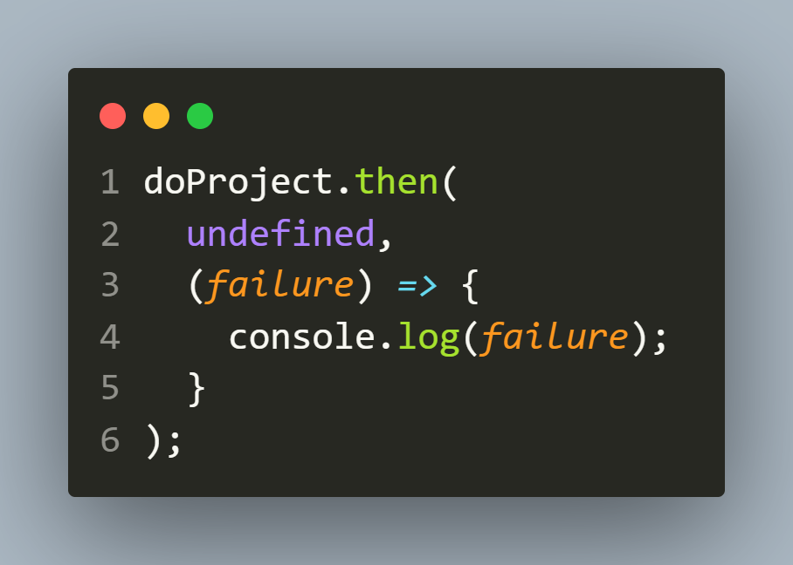
Handling only one state
And the following schedules a callback to handle the rejected case:

Slide 20
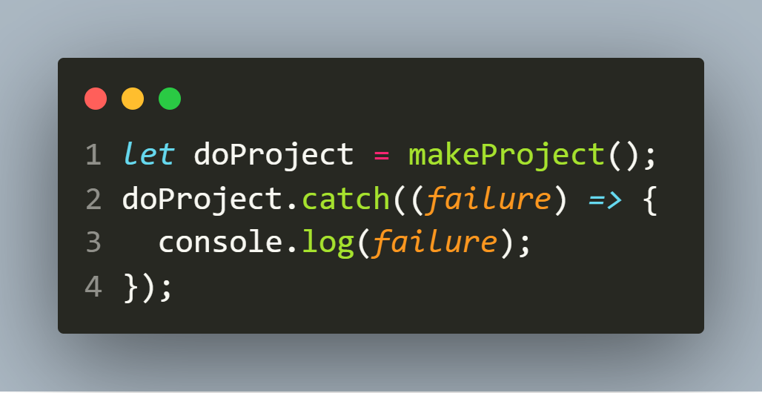
catch() method
If we want to schedule a callback to be executed when the promise is rejected, we can use the catch() method of the Promise object:

Slide 21
Then() method
Creating A Promise
Consuming A Promise

Slide 22
The finally() method
Sometimes, we may want to execute the same piece of code whether the promise is fulfilled or rejected.
For example, we may want to inform our team lead about the state of the project in either case .

Slide 23
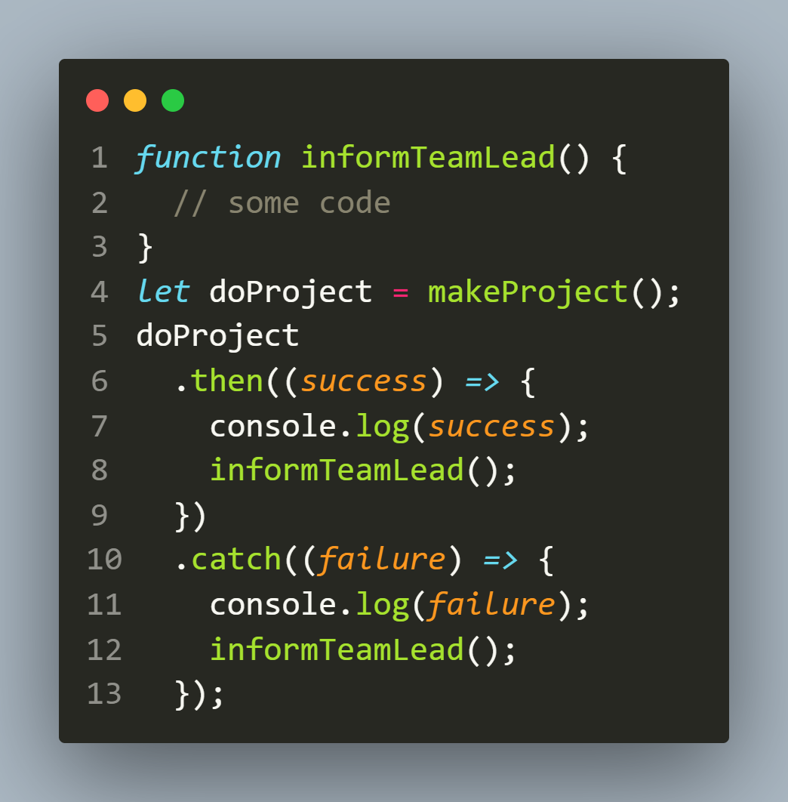
The finally() method

Slide 24
The finally() method
As we can see, the informTeamLead() function call is duplicated in both then() and catch() methods.
To remove this duplicacy and execute the informTeamLead() whether the promise is fulfilled or rejected, we can use the finally() method.

Slide 25
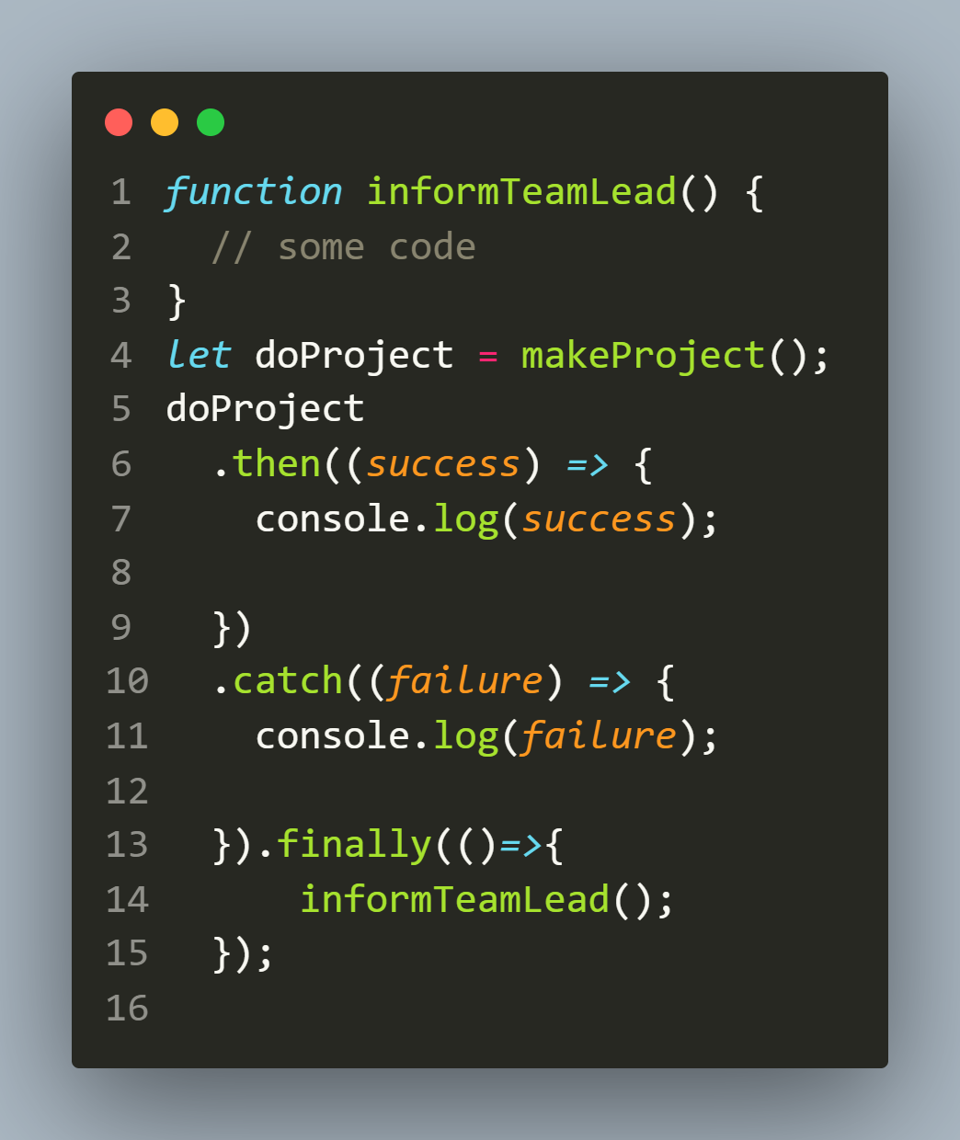
The finally() method

Slide 26
Exercise 6
Write an AJAX based application to do the
following:
Provide a button to the user and when the user clicks it call a function called makeProject().
This function should check whether argument passed is even or odd.
If it is even it should return the Promise object as fulfilled , otherwise it should return the Promise object as rejected
Finally depending on the state of Promise either display the message “I have completed the project” with happy emojis😊😊 or “I could not complete the project” with sad emojis 😒😒

Slide 27
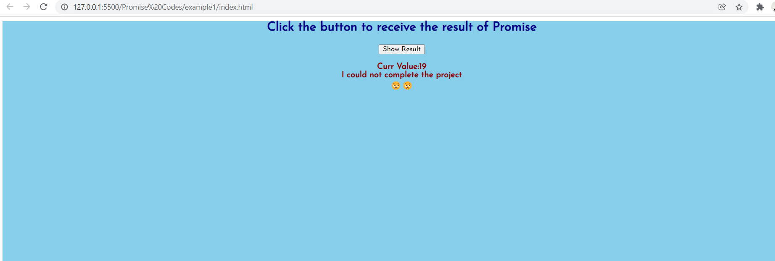
Desired output

Slide 28
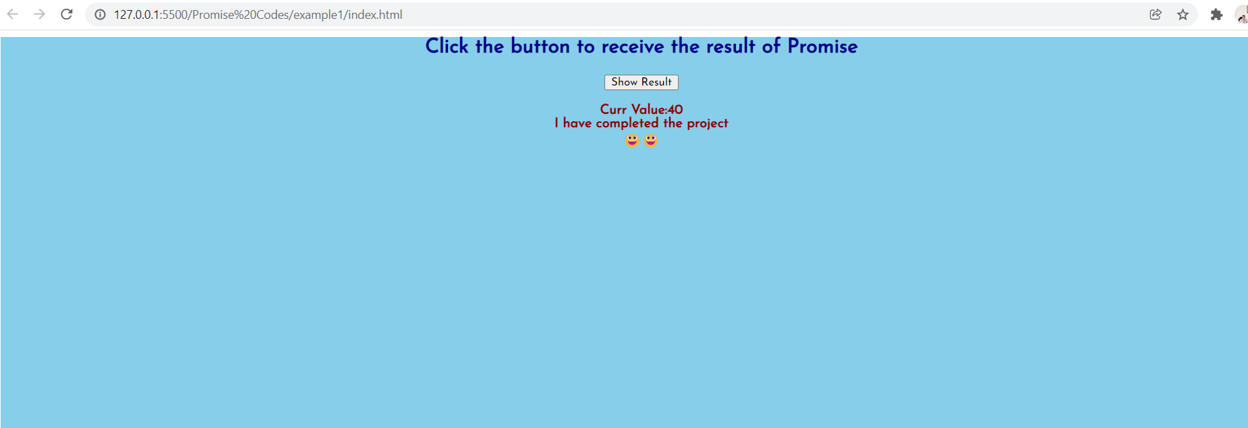
Desired output

Slide 29
Exercise 7
Modify the previous code so that the message “I have
completed the project” or “I could not complete the project”
gets displayed after a delay of 3 sec.

Slide 30
Exercise 8
Rewrite the first AJAX app that displayed India’s current date
and time by communicating with the api endpoint:
http://worldtimeapi.org/api/timezone/Asia/Kolkata
But this time use Promise API

Slide 31
Exercise 9
Rewrite the Countries app that displayed selected countries
Capital City, Flag and Currency using Promise API
The api endpoint is https://restcountries.com/v2/all

Slide 32

Thanks!
Any questions?
You can find me at:
Email id: info@scalive.in
Contact no. : +917314853128

